Slide 1
WP4 Use cases, Requirements and System Architecture
Leader: DSTL (CAST)
Participants : CERTH, RISSC, DITSS, ISBR, KWPG, AoC, NPN, GDCOC, LPV
Meeting
Belgrade, 9-11 October 2018

Slide 2
Table of contents
Use case 1: Counterfeit/falsified medicine, drugs and NPS
Scenario 1: Cyberspace Drug Trafficking Serbia
Scenario 2: Drug Dealer
Scenario 3: Delivery Of Drugs At An Address
Scenario 4: Counterfeit/falsified medicine, drugs and NPS
Scenario 5: Counterfeit/falsified medicine, drugs and NPS
Scenario 6: Buy substances in order to make drugs
Scenario 7: Europe’s migrant crisis in 2015

Slide 3
Table of contents
Use case 2: Weapons and Firearms trafficking
Scenario 1: Cyberspace Weapons Trafficking
Scenario 2: Weapons - hidden parts
Scenario 3: Weapons - mockups
Scenario 4: Weapons - show off
Scenario 5: Weapons - gun education
Use case 3:Terrorism Funding
Scenario 1: Terrorism Funding 1
Scenario 2: Terrorism Funding 2
Scenario 3: Terrorism Funding 3
Scenario 4: Terrorism Funding
Scenario 5: Terrorism Funding

Slide 4
Meanings of colors
The task has been extensively completed
No input has been provided yet
Additions and corrections are needed
Examples or explanations

Slide 5
Use case 1: Counterfeit/falsified medicine, drugs and NPS
Responsible partners : AoC, LPV, GDCOC, NPN, KWPG

Slide 6
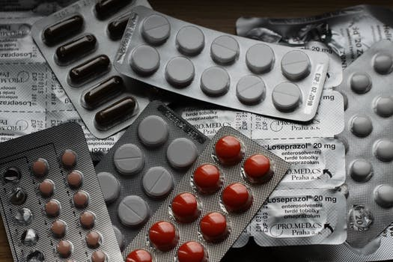
Use case 1: Counterfeit/falsified medicine, drugs and NPS
Outline problem:
There is a huge global market for drugs
Pharmaceuticals, Narcotics, Novel Psychoactive Substances and Counterfeit Medicines
Facilitated by anonymous, quick online transactions leading to:
Financial impact on EU nations
Adverse impact on public health

Slide 7
Use case 1: Counterfeit/falsified medicine, drugs and NPS
Outline approach:
Detect and Monitor trafficking activities
Public Web. Dark Web, Deep Web
Analyse heterogeneous multimedia large-scale data
Adopt High Levels of Automation
Increase accuracy
Learning from the investigator experience
Backwards feedback

Slide 8
Scenario 1: Cyberspace Drug Trafficking Serbia
AoC - Serbia

Slide 9
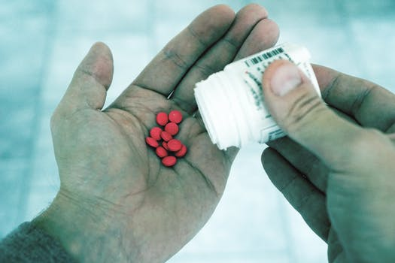
Scenario 1: Cyberspace Drug Trafficking Serbia (AoC)
Scenario description:
Phishing emails
Bulk email lists sold on dark net
Users tricked to click links
Fake sites
Malicious software
Users knowingly click links and enter payment details:
One time fraud, goods not delivered
Multiple frauds through harvesting and selling payment details
No fraud but fake / falsified drugs delivered
Drugs supplied not licensed in this region
Drugs supplied cause illness or death

Slide 10
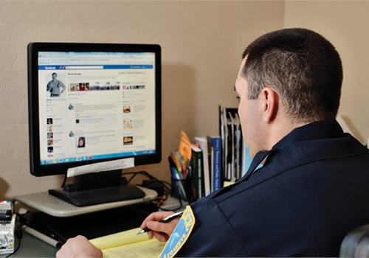
Scenario 1: Cyberspace Drug Trafficking Serbia (AoC)
Current practices :
Manual review of emails
Headers, links, embedded objects
Website use (as a “victim”)
Through TOR, Virtual or Live OS
Becoming a honeypot
Determine site origin / owner

Slide 11
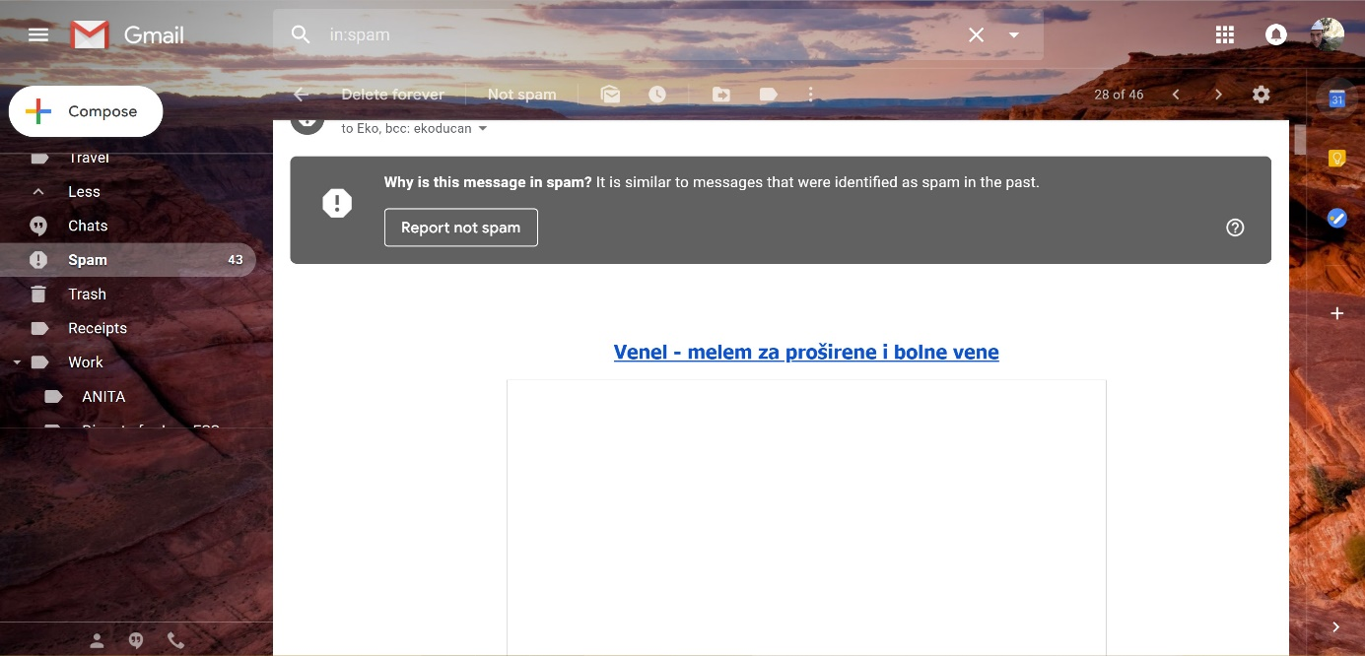
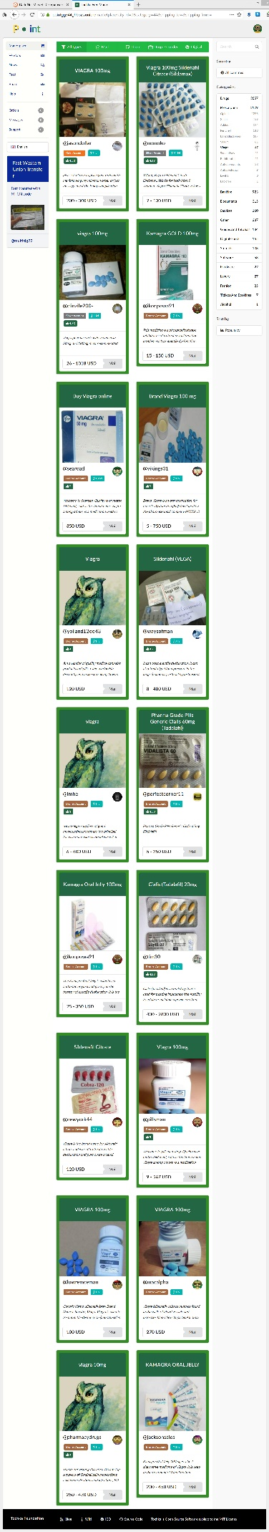
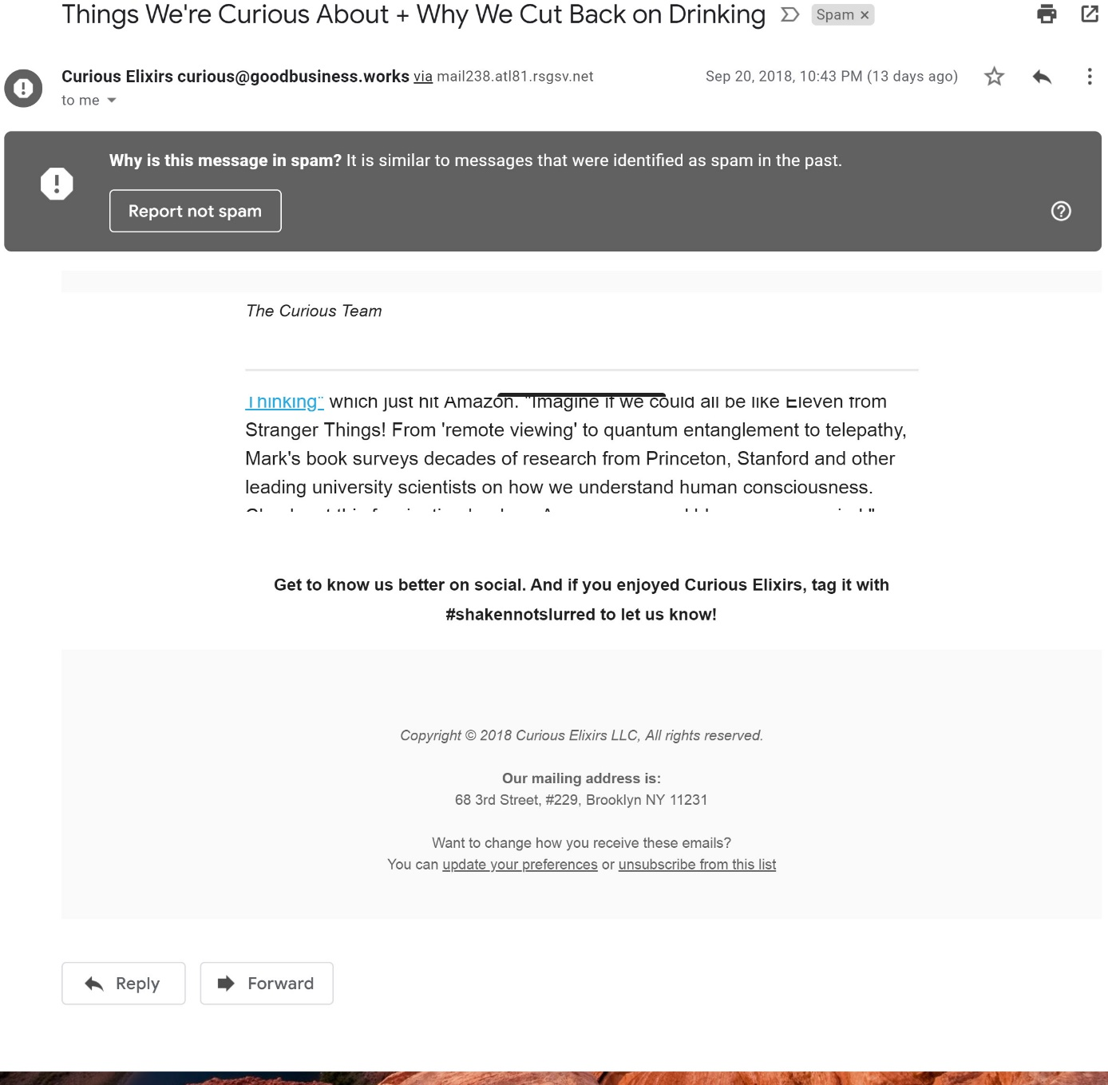
Scenario 1: Cyberspace Drug Trafficking Serbia (AoC)
Data to be used:
Only fake/pubic data is available
Three pictures that describe the datasets have been sent
No specific keywords are provided yet

Slide 12
Scenario 1: Cyberspace Drug Trafficking Serbia (AoC)
Objectives :
Analysis should be for headers of the email messages, whois lookup, contacts with originating countries police and other institutions Public prosecutor, Courts, 24/7 contact points in order for preserving digital evidence. Image searches, advertising phrases searches solicitation of the reports from police in originating countries, open source intelligence (OSINT) provided data on people, firms, places, objects…
Search for images
Analysis of headers of email messages
Fraud advertising phrases

Slide 13
Scenario 1: Cyberspace Drug Trafficking Serbia (AoC)
Pending issues :
The images of the dataset are not enough, the partner should be sent a great amount of images (thousands or millions of images)
No specific keywords are provided
Status of action points of the last Telco:
AP1: Image dataset to be provided (as many images as possible)
partialy completed (pending issue 1)
AP2: To define how to analyze the data (scope of project, what to search for, etc.)
completed

Slide 14
Scenario 2: Drug Dealer
LPV - Belgium

Slide 15

Scenario 2: Drug Dealer (LPV)
Scenario description:
Drug users stopped in vehicle
Identify address drugs were sold
Address difficult to observe
Legislation
Risk of detection
Further Information collected
Open source
Police databases
House search undertaken
Dealer has cryptocurrency awareness
Some transactions made
Unable to trace
Three more dealers involved
Need to create a view of who knows who

Slide 16
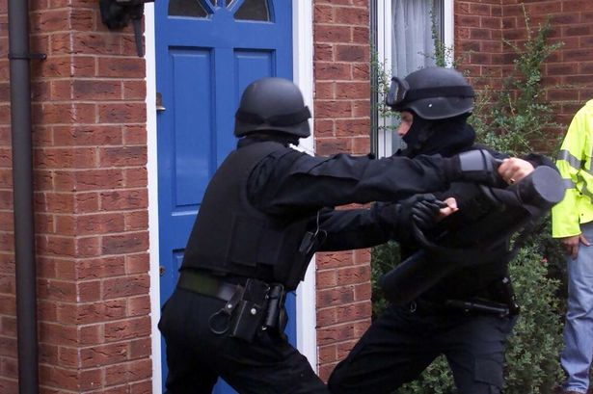

Scenario 2: Drug Dealer (LPV)
Current practices :
Information gathering & Observation
Police databases (formal)
Investigator can choose to invest in online research (informal)
Enough evidence leads to:
House search
Arrest
Confiscation of more evidence
Interrogation

Slide 17
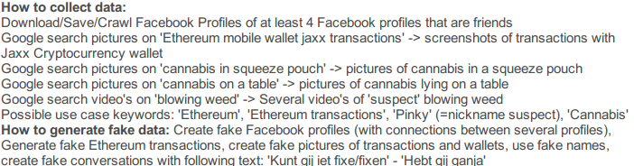
Scenario 2: Drug Dealer (LPV)
Data to be used:
Type of data : Persons, Items, Vehicles, Numbers, Items (Text, Image)
Official data - Not yet available, verdict on 31/10
Two Facebook accounts
Transaction data (images and text)
Two phone numbers
Cryptocurrency wallets (images and text)
Only fake/pubic data is available
keywords are provided

Slide 18
Scenario 2: Drug Dealer (LPV)
Objectives (a):
Input: A Facebook – Twitter – Instagram – Youtube … profile -> This could be in the form of a Facebook ID - Twitter name/ID - Instagram name/ID – Youtube URL/ID…
Output:
An overview of related pictures/videos (eg. found through a search on profile pictures and tagged pictures) on the web with their respective urls where they were found and all available metadata
Connections to other online profiles (Facebook, Twitter, Instagram)
Overview of common friends in the different found online profiles
In case of a nickname – overview of all found nicknames on the internet
Overview of references to address of the entered profile or an address found on one of the connected profiles

Slide 19
Scenario 2: Drug Dealer (LPV)
Objectives (b):
Input: Several Facebook/Twitter/Instagram profiles (to determine common entities like likes, group pages, friends …) -> in the form of Facebook ID - Twitter name/ID - Instagram name/ID – Youtube URL/ID
Output:
An overview of connections between the entered profiles like common likes, friends, following channels, group pages, addresses, names …Connections to other online profiles (Facebook, Twitter, Instagram …)

Slide 20
Scenario 2: Drug Dealer (LPV)
Objectives (c):
Input: A picture to find possible connections/similar pictures on the web -> Input should be in a standard format (jpg, gif, png, pdf …)
Output:
A list of identical/similar pictures, connections with other pictures or parts of a picture and their metadata

Slide 21
Scenario 2: Drug Dealer (LPV)
Objectives (d):
Input: A picture of a cryptocurrency wallet (in this case an Ethereum address) to follow-the-money trail -> the picture should be in a standard format (jpg, gif, png, pdf …), or the officer should simply input the wallet address through text in the system
Output:
A list of transactions to and from the wallet and their amounts, and if possible additional information about the receivers and senders of the transactions

Slide 22
Scenario 2: Drug Dealer (LPV)
Objectives (e):
Input: License plate/name/address/serial number … -> as text
Output:
Overview of all related information found on the web
General note: The officer should be able to choose for himself what kind of search should be performed: a wide search (no limitations), or specify one or more platforms like Facebook/Twitter/Instagram/Youtube …

Slide 23
Scenario 2: Drug Dealer (LPV)
Pending issues :
Provide the data when there are available (31/10)
Status of action points of the last Telco:
No action points

Slide 24
Scenario 3: Delivery Of Drugs At An Address
LPV - Belgium

Slide 25
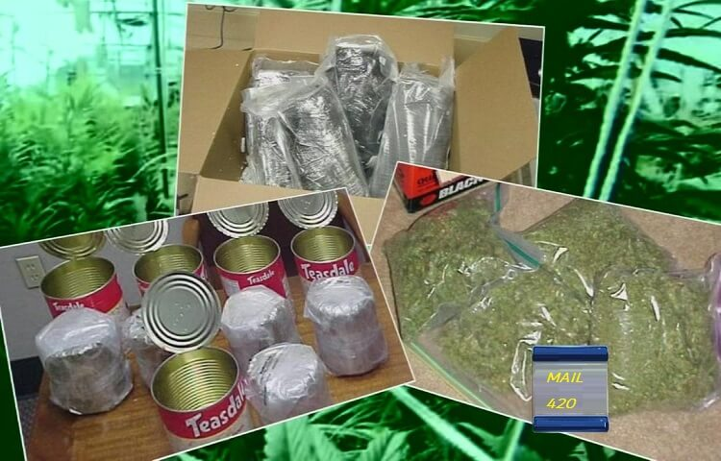
Scenario 3: Delivery Of Drugs At An Address (LPV)
Scenario description:
Drugs delivered to address
7 envelopes in 3 months
Using Belgian postal service
PO Box address owner identified
Admitted to buying narcotics on Dark Web using bitcoins
No follow up investigations to trafficking
Priorities and Capacity

Slide 26
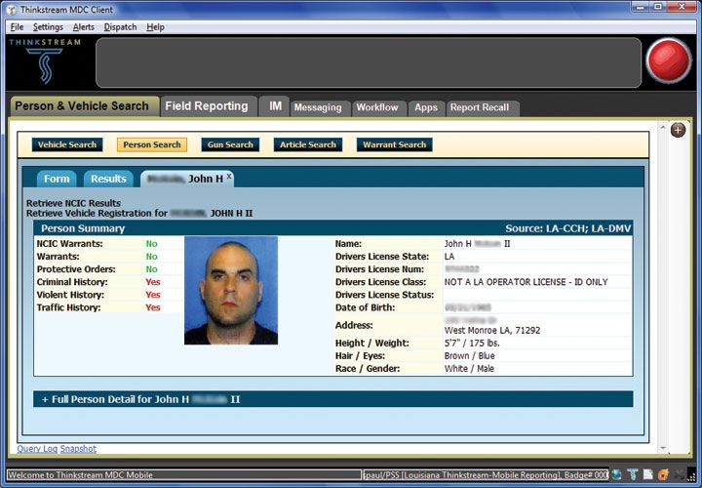
Scenario 3: Delivery Of Drugs At An Address (LPV)
Current practices :
Information gathering & Observation
Police databases (formal)
Investigator can choose to invest in online research (informal)
Wider knowledge of cryptocurrencies could have lead to further research
Possible Federal case

Slide 27
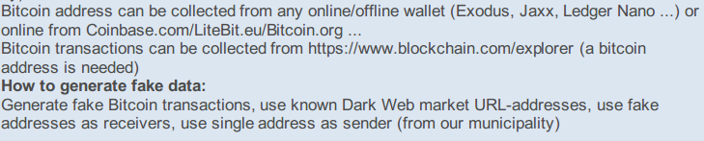
Scenario 3: Delivery Of Drugs At An Address (LPV)
Data to be used:
Only fake/pubic data is available
Type of data : Persons, adresses
Bitcoin address can be collected from any online/offline wallet (Exodus, Jaxx, Ledger Nano ...) or online from Coinbase.com/LiteBit.eu/Bitcoin.org ...
Bitcoin transactions can be collected from https://www.blockchain.com/explorer (a bitcoin address is needed)
use fake addresses as receivers,
Generate fake Bitcoin transaction
use known Dark Web market URL-addresses

Slide 28
Scenario 3: Delivery Of Drugs At An Address (LPV)
Objectives (a):
Input: License plate/name/address/serial number … -> as text, in this case multiple addresses could be used (addresses on the envelopes)
Output:
Overview of all related information found on the web
Objectives (b):
Input: The address of a cryptocurrency wallet (in this case a Bitcoin address) to follow-the-money trail, as text
Output:
A list of transactions to and from the wallet and their amounts, and if possible additional information about the receivers and senders of the transactions

Slide 29
Scenario 3: Delivery Of Drugs At An Address (LPV)
Pending issues :
No pending issues
Status of action points of the last Telco:
No action points

Slide 30
Scenario 4: Counterfeit/falsified medicine, drugs and NPS
GDCOC - Bulgaria

Slide 31
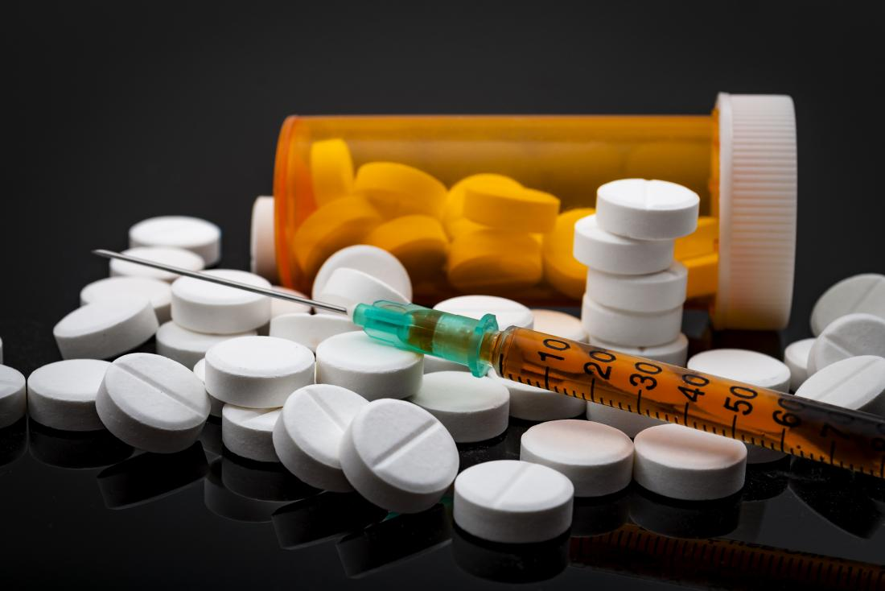
Scenario 4: Counterfeit/falsified medicine, drugs and NPS (GDCOC)
Scenario description:
The title of the scenario is missing
Buy drugs from a darknet marketplace
A person found the section in the a marketplace marked as of “opioids” and established a contact with the trader
The money have sent through a crypto-wallet
the virtual currency was Monero.
She received the drugs
one week after she done the transaction

Slide 32

Scenario 4: Counterfeit/falsified medicine, drugs and NPS (GDCOC)
Current practices :
Complaint leads to police check
Information gathered and analysed
Witness information, phone ownership, timeframes, names, roles on the Organised Crime Group
After analysis, determine what information could be used for further investigation
After police checks and forensics all information sent to prosecutors office

Slide 33
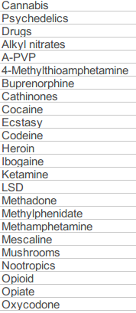
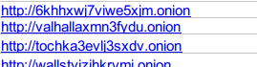
Scenario 4: Counterfeit/falsified medicine, drugs and NPS (GDCOC)
Data to be used:
Data about cases COULD be shared with prosecutors permission
OSINT data
Can we have access to these data?
Ammount of these data?
Fake/pubic data is available
Type of data : image? text?
Links and keywords are provided

Slide 34
Scenario 4: Counterfeit/falsified medicine, drugs and NPS (GDCOC)
Objectives:
provide information from Surface, Deep and Dark web search
find as much useful and relevant information as it can - Similarity search?
present the output in a simple and common format
present the output in a forensic secure way

Slide 35
Scenario 4: Counterfeit/falsified medicine, drugs and NPS (GDCOC)
Pending issues :
Titlte of scenario is missing
Provide real data if are available
What is the type of the data?
What is the amount of the data?
Provide links in order to download OSINT data
which should be the type of the data? (image, video, text or something else )
The objectives of the scenario need to be defined clearly, what should be the input and what should be the output of a possible generated tool
Status of action points of the last Telco:
Telco was not held - 2018/10/04

Slide 36
Scenario 5: Counterfeit/falsified medicine, drugs and NPS
NPN - Netherlands

Slide 37

Scenario 5: Counterfeit/falsified medicine, drugs and NPS (NPN)
Scenario description:
The current scenario is focused on the way that the information from any criminal case should be analyzed
complaints
anonymous information
witnesses information from other criminal cases
Title : “Analyzing information regarding of possible suspects”

Slide 38
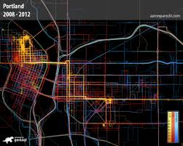
Scenario 5: Counterfeit/falsified medicine, drugs and NPS (NPN)
Current practices :
All information will be gathered
i.e. GPS, nickname, username, organisation names, names and roles within the network, timeframes
Determine if any related personal information is available
Determine if the personal information can be used in internet searches
Risks of sharing search information in browser etc.

Slide 39
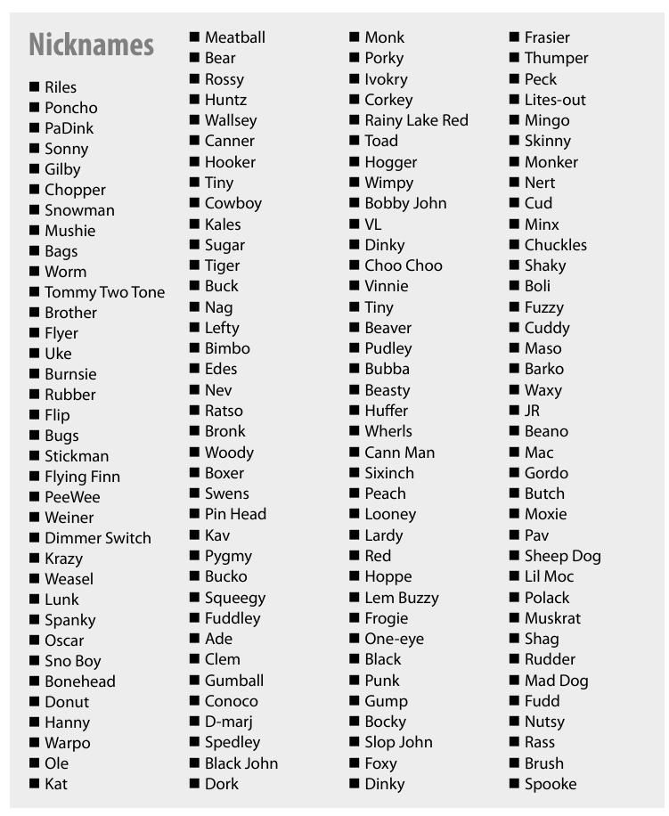
Scenario 5: Counterfeit/falsified medicine, drugs and NPS (NPN)
Current practices :
If useful information found, investigator to determine
what can be used for further investigation
is information related to the investigation or a false positive
Information downloaded and made available in a forensic way
At agreed points Public Prosecutor contacted for legal approval

Slide 40
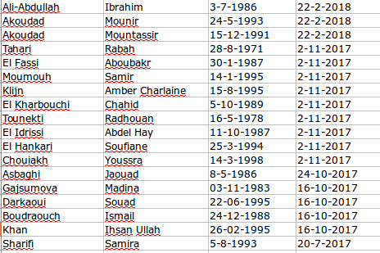
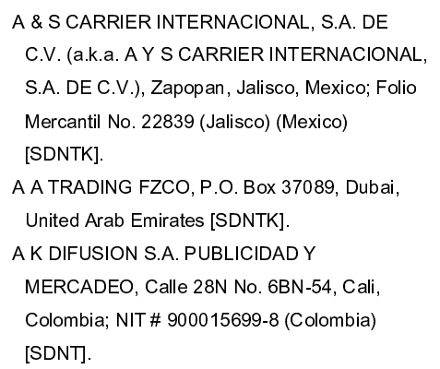
Scenario 5: Counterfeit/falsified medicine, drugs and NPS (NPN)
Data to be used:
OSINT data are provided, especially keywords in order to generate a public dataset
Text data:
names and surnames
ip adresses
emails (text)
queries (text)
Visual and text data:
online web sites (sites of drugs)
social media accounts

Slide 41
Scenario 5: Counterfeit/falsified medicine, drugs and NPS (NPN)
Objectives :
“Build an internet profile for a person in order to decide if this user/person is suspect or not. Additionaly, the berhavior of the person should be cachted from the system. Specifically, the non-physical behaviour (possible the person has make use of drugs should be detected). Furthermore, criminal activities such as online drug selling should be detected.”
Input: A picture that describes e.g. a NPS should be fed as input.
Output: A set of similar content should be presented, in this case pictures that contains NPS should be returned
Input: A facebook profile of a possible suspect could be gived as input.
Output: A set of a text and visual content should be returned. The system should define if this person is possible suspect after analyzing his identity (person detection) on large scale databases
Input : set of videos could be given as input
Output: detection of non-physical actions such as make use of a drung , drug effects should be extracted.

Slide 42
Scenario 5: Counterfeit/falsified medicine, drugs and NPS (NPN)
Pending issues :
Titlte is missing. Does the parther agree with the selected tittle?
The scenario Narrative is missing
Additional feedback is necessary
Does the partner agree with the aforementioned objectives of the scenario?
Status of action points of the last Telco:
No action points

Slide 43
Scenario 6: Buy substances in order to make drugs
KWPG - Poland

Slide 44
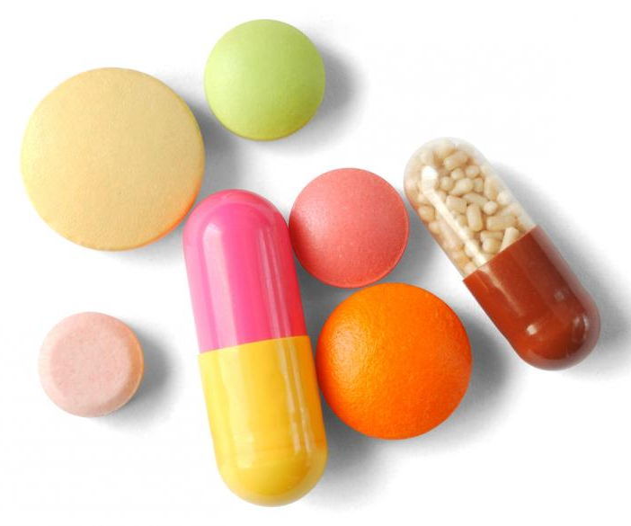
Scenario 6: Buy substances in order to make drugs (KWPG)
Scenario description:
There was an internet website: http://www.odczynnikichemiczne.net.pl
It was possible to buy on this website all the chemical substances which are needed to produce NPS. Most of them were NPS itself.
Make profit by working on the edge of law
Importing NPS from China, middle east, Balkans, and other countries
Selling variaty of quantities
Accepted payments in cash, money transfers cryptocurrecnies and others.

Slide 45
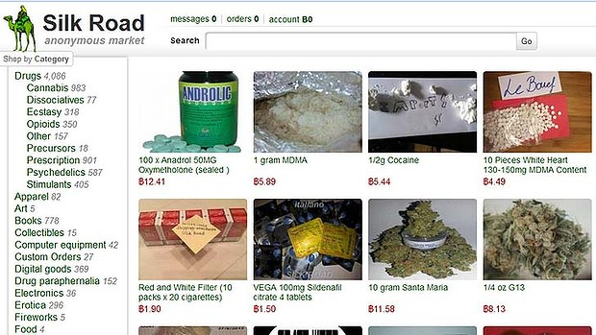
Scenario 6: Buy substances in order to make drugs (KWPG)
Current practices :
It was important to establish all the individuals who bought the stuff in order to be able to prove that the suspect was launching new products which are dangerous for huma’s life and health and that he was aware of it.
We were manually searching the internet for above mentioned frazes and for all pieces of information we had about the buyers
Within this case and others – as a monitoring of the phenomena – we are also trying to find out where were the photos taken and the movies made, who is in the photos and movies

Slide 46
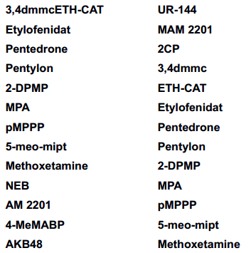
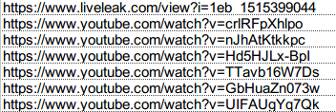
Scenario 6: Buy substances in order to make drugs (KWPG)
Data to be used:
Only fake/pubic data is available
Type of data : active substances of NPS, few images
keywords, links , youtube videos are provided

Slide 47
Scenario 6: Buy substances in order to make drugs (KWPG)
Objectives :
Visual data could be used in order to achieve the objectives of the scenario. Specifically, a dataset of images could be used in order to detect persons in photos, additionally similar images could be founded given an image that not included on the dataset
Gain as much information as possible of specific adevertisments , behavior, of one subject, sellings nps, fake drugs.
Similarity searching in a variatey of type such as : sites, keywords, goods, anabolic steroids, same packages of different site.
Find relations of physical persons among the buyers
The task is to figure out if these pictures are somewhere in the net and what is the location.
where were the photos taken and the movies made, who is in the photos and movies

Slide 48
Scenario 6: Buy substances in order to make drugs (KWPG)
Pending issues :
Tittle is missing
“Buy substances in order to make drugs”
Does the partner agree with the selected title?
Status of action points of the last Telco:
AP9 To make the objective clearer to what we are going to search in the dataset (search for similar advertisements for NPS or fake drugs and any relation to the physical person selling it)

Slide 49
Scenario 7: Europe’s migrant crisis
KWPG - Poland

Slide 50
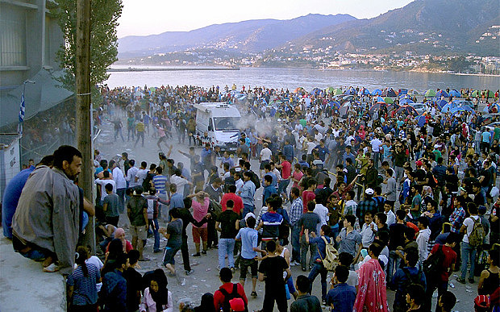
Scenario 7: Europe’s migrant crisis in 2015
Scenario description:
Organised criminal groups organise flats, cars, navigations and phones, they find immigrants described as above and they offer them relatively “easy money”
The merchandise is described as legal
The customers can find list of provided goods on internet sites, forums, social media the prices are set and the fee for deliver is the profit of immigrant
The advertisements in internet are often published from one or several ip addresses and its layout an phrases are similar to one each other.

Slide 51
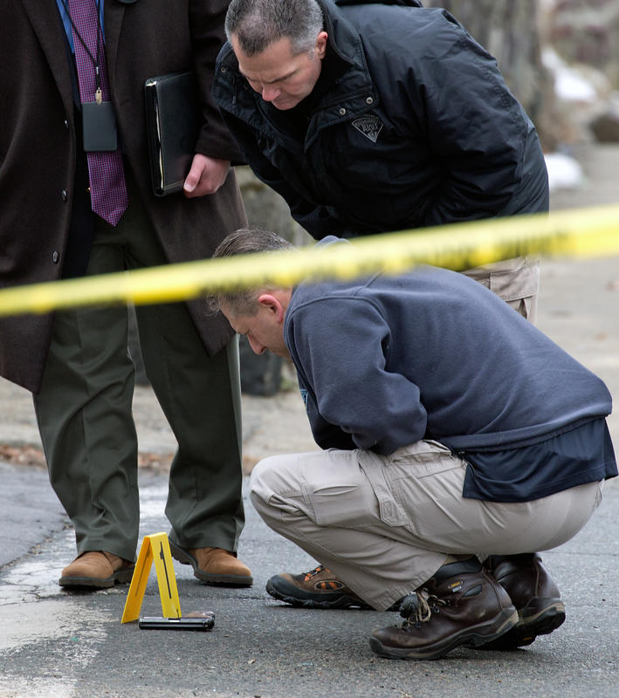
Scenario 7: Europe’s migrant crisis in 2015
Current practices :
Judge the information – if it is reliable, if there are more than one similar advertisments with similar phone numbers posted in the internet.
Start operational work – gathering intelligence, other information, confirming the source, trying to establish all individuals who are involved, checking the phone billings of numbers given in ads, If necessary tapping or other ways of survailance like observe the package, change the package…..
when all the information is enough to launch the case, all information are transferred to the prosecutor offic

Slide 52
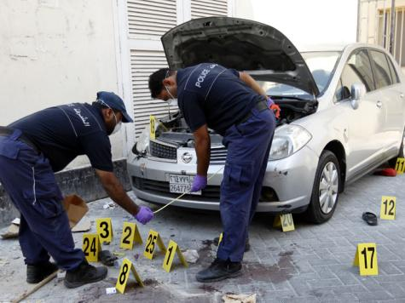
Scenario 7: Europe’s migrant crisis in 2015
Current practices :
official investigation starts, operational officers may still be involved and search for information, but from now on the prosecutor is involved
In this use case if officers manage to establish the individuals and prosecutor agreed the perpetrators may be arrested and bring to the judge who decides if the should be arrested for 1, 2 or 3 mounths
Police officially gather evidences and lead the case which may means hearing the witness, examminig data sources like criminals’ phones, criminals’ computers, analyse all internet data and present conclusions to the prosecutor
Bring the accusation to prosecutor

Slide 53
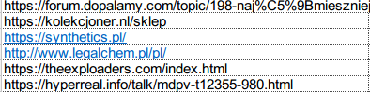
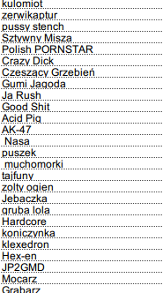
Scenario 7: Europe’s migrant crisis in 2015
Data to be used:
Only fake/pubic data is available
Type of data : IP addresses and emails, pictures, nicknames , phone numbers
keywords, links , youtube videos are provided

Slide 54
Scenario 7: Europe’s migrant crisis in 2015
Objectives :
Data analysis and internet scanning for key words / phrases / text layout which would indicate an announcement with the same background, similar contents, photos, phone numbers, e-mail addresses, style of writing, movies, look for other (all kinds) of places on the internet where above mentioned pieces of information may appear which could help in identifying the individuals
Specifically, similarity searching can be applied not only on visual content, but also on text or email content.

Slide 55
Scenario 7: Europe’s migrant crisis in 2015
Pending issues :
Tittle is missing
“Europe’s migrant crisis”
Does the partner agree with the selected title?
What is the objective?
Available forensic data for investigation?
Please provide the data that the officer should have in order to start the investigation
What type of data? What type of open source data? What type of phrases?
Status of action points of the last Telco:
AP9 To make the objective clearer to what we are going to search in the dataset (search for similar advertisements for NPS or fake drugs and any relation to the physical person selling it)

Slide 56
Use case 2: Weapons and Firearms trafficking
Responsible partners : AoC, KWPG

Slide 57
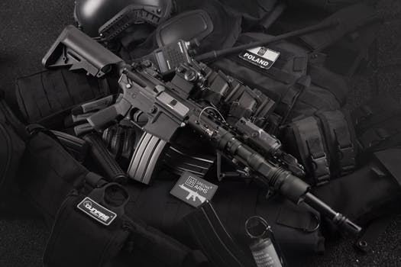
Use case 2: Weapons and Firearms trafficking
Outline Problem :
Trafficking spread across criminal and terrorist activities
Aided by easy anonymous internet trading
Weapons trafficking supports wider criminal activity
Detecting and acting upon weapons trafficking reduces the risk of murder or attack

Slide 58
Use case 2: Weapons and Firearms trafficking
Outline approach:
Detect weapon trafficking activities
Monitor activities and identify individuals
Adopt High Levels of Automation
Integrate knowledge from Big Data sources

Slide 59
Scenario 1: Cyberspace Weapons Trafficking
AoC - Serbia

Slide 60
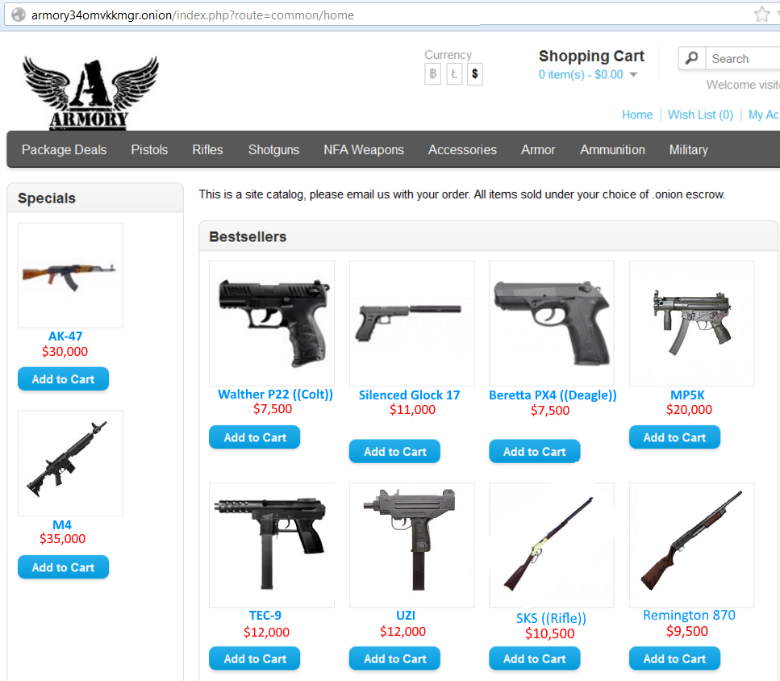
Scenario 1: Cyberspace Weapons Trafficking (AoC)
Scenario description:
Mostly originating from darknet
Illegal advertising of equipment and prices
Paying in blockchain
What is the evidence data and what are the databases to be analyzed

Slide 61

Scenario 1: Cyberspace Weapons Trafficking (AoC)
Current practices :
Website use (as a “buyer”)
Through TOR, Virtual or Live OS
Investigators specialist expertise in firearms and weapons
Pre trial mode
Determine Jurisdiction
Special police sections for terrorism and extremism
Produce and issue documentation

Slide 62
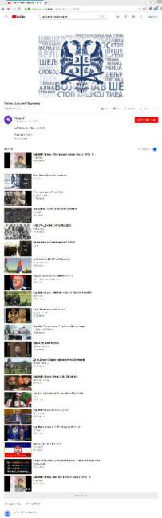
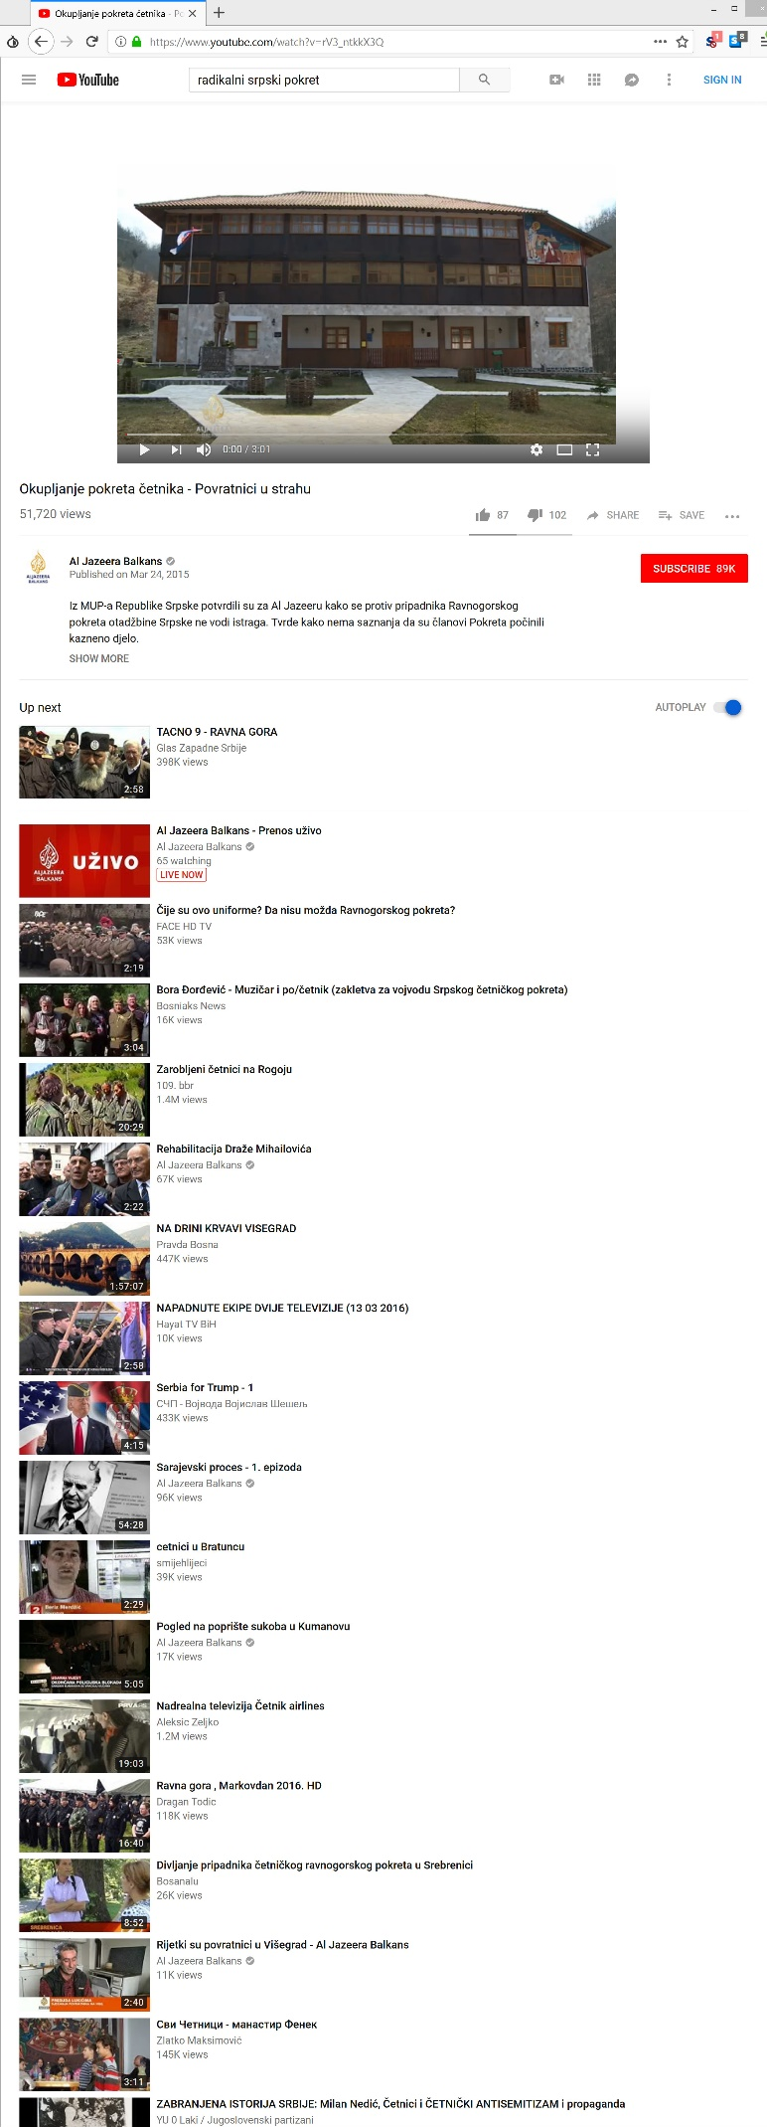
Scenario 1: Cyberspace Weapons Trafficking (AoC)
Data to be used:
Only fake/pubic data is available
Type of data : audio, video and text should be generated
youtube videos are provided
To create fake data videos can be obtained from the address:
https://www.youtube.com/watch?v=dq0tvWiCMH8
https://www.youtube.com/watch?v=DBVg_pfpBQA I https://youtu.be/VKnzlhWeX4g
all the connected videos can be used in creating of radical and extremist movement in Serbia – non Islam, and for the Radical Islamist movement

Slide 63
Scenario 1: Cyberspace Weapons Trafficking (AoC)
Objectives :
“All phrases to be searched in relation to: jihad + war + sheitan + holy war for Islam. Serbian Šejtan, džihad, sveti rat, četnici, koljači, prljavi srbi, protivnici Islama. Četničke vojvode, velika Srbija, Šešeljizam, dveri, pokret Srbije… In the order to cover their activities there are indicia’s that they are offering on the grey market weapons and guns. In general there is assumption that through surveillance of the radicals and extremists is possible to reveal grey markets on the real life. They are not offered online. “
-- The above description is not clear...

Slide 64
Scenario 1: Cyberspace Weapons Trafficking (AoC)
Pending issues :
Narration need to be extended
More youtube video links should be very helpful
Objectives should be defined more clearly
What is the evidence data and what are the databases to be analyzed
Status of action points of the last Telco:
AP3: Scenario definition to be completed (perform multimodal analysis -audio, video, text- to find influencers, to search for political and other people related to weapons trafficking)
AP4: To create fake data
AP5: To define how to analyze the data (scope of project, what to search for, etc.)

Slide 65
Scenario 2: Hidden parts
KWPG - Poland

Slide 66
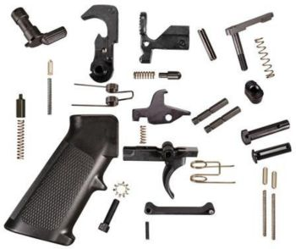
Scenario 2: Weapons - hidden parts (KWPG)
Scenario description:
Selling firearm parts (local announcement sites, internet auction sites etc.)
Contact seller for more information
Seller could establish if buyer could be sold illegal firearms
Parts concealed
Several parcels , mixed with other items
Parts delivered to mailbox not residence
Sent from differing addresses
Police found several announcements
All similar in lay out and style
Posted from different public hotspots
Posted from different devices

Slide 67
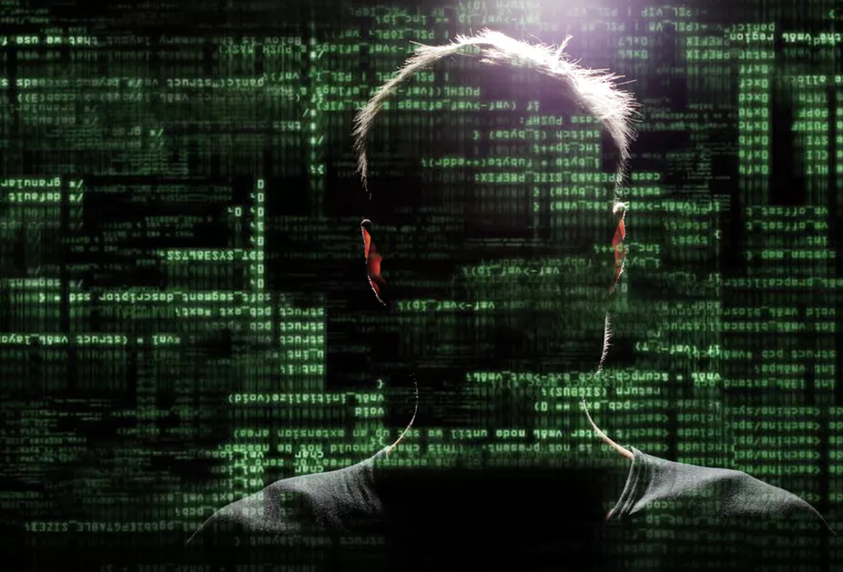
Scenario 2: Weapons - hidden parts (KWPG)
Current practices :
Judge the information – if it is reliable
Start operational work – gathering intelligence, other information, confirming the source, trying to establish all individuals who are involved
In this use case if officers manage to establish the individuals and prosecutor agreed the perpetrators may be arrested and bring to the judge who decides if the should be arrested for 1, 2 or 3 month's
Police officially gather evidences and lead the case which may means hearing the witness, examining data sources like criminals’ phones, criminals’ computers, analyse all internet data and present conclusions to the prosecutor

Slide 68
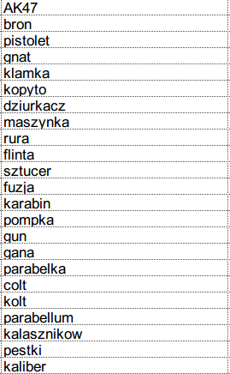
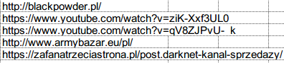
Scenario 2: Weapons - hidden parts (KWPG)
Data to be used:
Only fake/pubic data is available
Type of data : emails, ip adresses
We need to specify how the offices use the e-mails and ip adresses. Additionaly, is should be specify what the emals describe? Who is the sender? (seller-buyer), Whos ip adress the officer looks up
keywords and a few links are provided

Slide 69
Scenario 2: Weapons - hidden parts (KWPG)
Objectives :
“The task is to figure out similar content on the web . The parts were sending to the buyer in several parcels always with some other objects in it or concealed as something else to avoid being uncovered.”
(text or video similarity )
The above scenario can be directly correlated with the possible generated datasets. Specifically, similarity searching can be applied not only on visual content, but also on text or email content.

Slide 70
Scenario 2: Weapons - hidden parts (KWPG)
Pending issues :
Does the partner agrees with the aforementioned objectives of the scenario?
What are the evidence data and what are the databases to be analysed?
this case based mostly on e-mails and IP adresses
Status of action points of the last Telco:
AP10: To define in detail the performed tasks on the datasets (search based on visual similarity or text queries?)

Slide 71
Scenario 3: Mock ups
KWPG - Poland

Slide 72
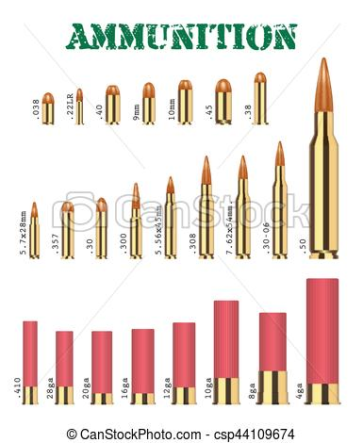
Scenario 3: Weapons - mockups (KWPG)
Scenario description:
Issuing fake documents
Identity Theft
Banking fraud
Search revealed
Fake documents
Firearms, Sniper files
Ammunition (over 1000 pieces)
Mobile phone and computer evidence
Obtaining Weapons, weapon parts and ammunition via a internet announcement website
Contacting others and trading weapons and ammunition
Using images of fully acting weapons/ ammunition presented as mockups or empty shells

Slide 73
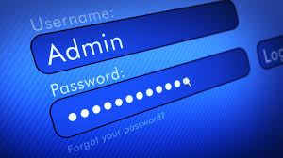
Scenario 3: Weapons - mockups (KWPG)
Current practices :
Ask prosecutor to ask website administrator for user’s personal data and transaction history, then analysing them for information that may confirm crime operations.
In the next step, asking the administrator for personal data of users that had been involved in questionable transactions and after gathering this information – applying, to prosecution, for search warrants in their places of residence.
Police officially gather evidences and lead the case which may means hearing the witness, examining data sources like criminals’ phones, criminals’ computers, analyse all internet data and present conclusions to the prosecutor

Slide 74
Scenario 3: Weapons - mockups (KWPG)
Data to be used:
Only fake/pubic data is available
Type of data : emails, ip adresses
We need to specify how the offices use the e-mails and ip adresses. Additionaly, is should be specify what the emals describe? Who is the sender? (seller-buyer), Whos ip adress the officer looks up
keywords and a few links are provided

Slide 75
Scenario 3: Weapons - mockups (KWPG)
Objectives :
“On the internet announcements fully acting weapon or ammunition was presented as mockups or as components, e.g. bullets were presented as shells.”
(text or video data)
The above scenario can be directly correlated with the possible generated datasets. Specifically, weapon detection can be applied.

Slide 76
Scenario 3: Weapons - mockups (KWPG)
Pending issues :
Does the partner agrees with the aforementioned objectives of the scenario?
What are the evidence data and what are the databases to be analysed?
this case based mostly on e-mails and IP adresses
Status of action points of the last Telco:
AP10: To define in detail the performed tasks on the datasets (search based on visual similarity or text queries?)

Slide 77
Scenario 4: Show off
KWPG - Poland

Slide 78

Scenario 4: Weapons - show off (KWPG)
Scenario description:
Social media search finds male posing with weapon
Comments about weapons power
Hate speech
Suggestion he might be remodeling legal guns to use for combat ammunition
Search of workplace and home revealed
Collectible, sporting and noisemaking weapons
Ammunition, weapon parts and adaptation/manufacturing equipment
Documentation indicated the source was from legal Polish and Czech stores

Slide 79
Scenario 4: Weapons - show off (KWPG)
Current practices :
Ask prosecutor to ask website administrator for user’s personal data and transaction history, then analysing them for information that may confirm crime operations.
In the next step, asking the administrator for personal data of users that had been involved in questionable transactions and after gathering this information – applying, to prosecution, for search warrants in their places of residence.
Police officially gather evidences and lead the case which may means hearing the witness, examining data sources like criminals’ phones, criminals’ computers, analyse all internet data and present conclusions to the prosecutor

Slide 80
Scenario 4: Weapons - show off (KWPG)
Data to be used:
Only fake/pubic data is available
Type of data : emails, ip adresses
We need to specify how the offices use the e-mails and ip adresses. Additionaly, is should be specify what the emals describe? Who is the sender? (seller-buyer), Whos ip adress the officer looks up
keywords and a few links are provided

Slide 81
Scenario 4: Weapons - show off (KWPG)
Objectives :
“While searching social media, police officers found a male’s profile with photos of him posing with a weapon. ”
What is the objectives???
The above scenario can be directly correlated with the possible generated datasets. Specifically, person detection can be applied. This similarity should be managed as visual similarity.

Slide 82
Scenario 4: Weapons - show off (KWPG)
Pending issues :
Does the partner agrees with the aforementioned objectives of the scenario?
What are the evidence data and what are the databases to be analysed?
this case based mostly on e-mails and IP adresses
Status of action points of the last Telco:
AP10: To define in detail the performed tasks on the datasets (search based on visual similarity or text queries?)

Slide 83
Scenario 5: Gun education
KWPG - Poland

Slide 84
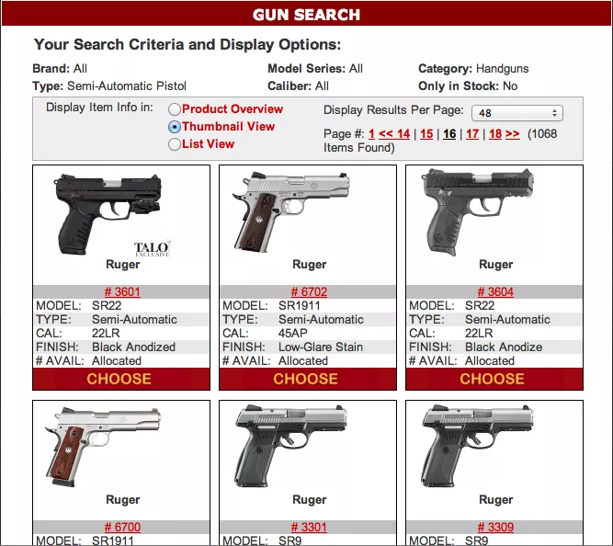
Scenario 5: Weapons - gun education (KWPG)
Scenario description:
User wants to buy a weapon
Searches on forums and blogs
asks questions
posts comments
Answers from other posters given via private message
Gmail.com (USA)
Mail.ru (Russia)
Out of jurisdiction for the police

Slide 85
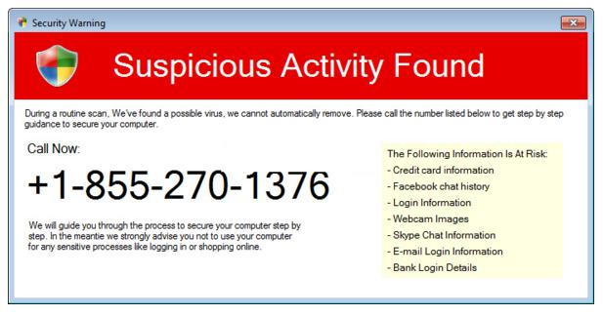
Scenario 5: Weapons - gun education (KWPG)
Current practices :
Monitoring forum comments is manual, not automated
Suspicious information leads to further search for individuals involved
Website / forum owners contacted for more information

Slide 86
Scenario 5: Weapons - gun education (KWPG)
Data to be used:
Only fake/pubic data is available
Type of data : emails, urls, forum posts
We need to specify how the offices use the e-mails and ip adresses. Additionaly, is should be specify what the emals describe? Who is the sender? (seller-buyer), Whos ip adress the officer looks up
keywords and a few links are provided

Slide 87
Scenario 5: Weapons - gun education (KWPG)
Objectives :
“To get the information individual starts browsing online forums on this subject and asking questions, writing comments on various forums, blogs e.g. ”
Matching similar background, text, images, phone numbers, email addresses, video, style of writing
(text or video similarity )
The above scenario can be directly correlated with the possible generated datasets. Specifically, the aforementioned objective can be matched with a fraud detection tool. Taking into account that a web site includes a fraud the officer should have the ability to view detect these sites or to detect visual content that is not seems reliable (e.g a gun inside a pc)

Slide 88
Scenario 5: Weapons - gun education (KWPG)
Pending issues :
Does the partner agrees with the aforementioned objectives of the scenario?
What are the evidence data and what are the databases to be analysed?
this case based mostly on e-mails and IP adresses
Current practices should be elaborated
Status of action points of the last Telco:
AP10: To define in detail the performed tasks on the datasets (search based on visual similarity or text queries?)

Slide 89
Use case 3: Terrorism Funding
Responsible partners : LPV, NPN, CAST

Slide 90
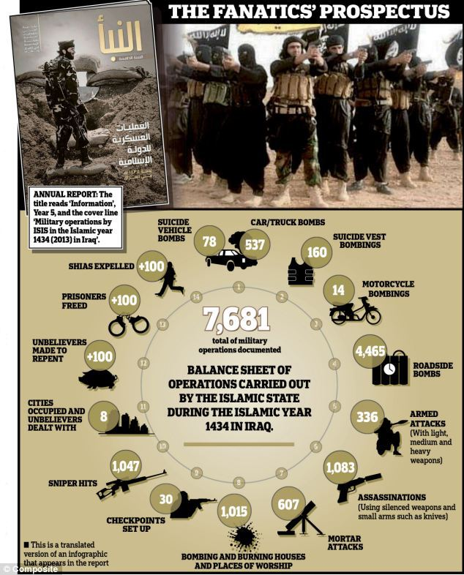
Use case 3:Terrorism Funding
Outline Problem :
Fund trafficking is key to all terrorist organizations
Facilitated by anonymous, quick online transactions
Illegal goods trafficking
Deep Web funds transfer
Money laundering
Significant burden for LEA officers to detect and identify suspects

Slide 91
Use case 3:Terrorism Funding
Outline approach:
Automatically detect and monitor financial networks and flows
Dark Web, Deep Web
Web crawling to retrieve data
Analyse heterogeneous multimedia data
Multi source Big Data
Identify, control and disrupt fund trafficking

Slide 92
Scenario 1: Terrorism Funding 1
LPV - Belgium

Slide 93
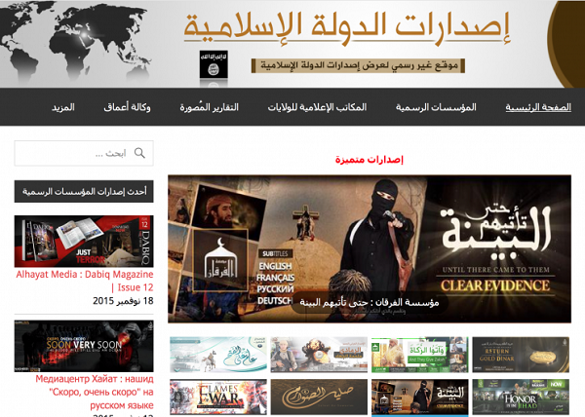
Scenario 1: Terrorism Funding 1 (LPV)
Scenario description:
Asylum seeker in shelter displays indicators of terrorist behavior or radicalisation
They use facilities of the shelter
Phone, smartphone, computer
Social service notify LEA of disturbing behaviour
The narration of the scenario should be extended
The title of the scenario is missing

Slide 94
Scenario 1: Terrorism Funding 1 (LPV)
Current practices :
Interview representatives:
Social service, asylum shelter, etc.
Investigators choice to use internet investigation and the extent of that search
Interrogate target, perform a house search, confiscate material for evidence

Slide 95
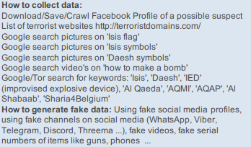
Scenario 1: Terrorism Funding 1 (LPV)
Data to be used:
Only fake/pubic data is available
Type of data :
video and images
keywords and links of how to use them are provided

Slide 96
Scenario 1: Terrorism Funding 1 (LPV)
Objectives :
“Detect radicalization of persons which using social media”
A dataset that should contain videos of terrorism content can be used in order to detect persons or vehicles that probably matched with the suspects. Additionally items such as flags or clothes can be detected. Clothes possible gives a sign of radicalization.

Slide 97
Scenario 1: Terrorism Funding 1 (LPV)
Pending issues :
The narration of the scenario should be extended
What is the objective? e.g to detect persons that have radicalized ?
The title of the scenario is missing
What are the evidence data and what are the databases to be analysed?
Status of action points of the last Telco:
No action points

Slide 98
Scenario 2: Terrorism Funding 2
LPV - Belgium

Slide 99
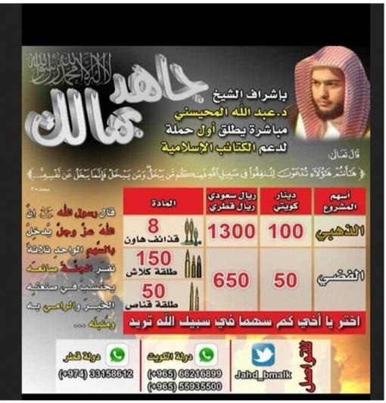
Scenario 2: Terrorism Funding 2 (LPV)
Scenario description:
Young adult at school displays disturbing behavior or radicalisation
Starts to wear a burka
Family is isolated and unwilling to engage
The narration of the scenario should be extended
The title of the scenario is missing

Slide 100
Scenario 2: Terrorism Funding 2 (LPV)
Current practices :
Interview representatives:
School teacher, Headmaster etc.
Investigators choice to use internet investigation and the extent of that search
Talk to family and provide assistance if necessary
Interrogate target, perform a house search, confiscate material for evidence

Slide 101
Scenario 2: Terrorism Funding 2 (LPV)
Data to be used:
Only fake/pubic data is available
Type of data :
video and images
keywords and links to search the queries are provided

Slide 102
Scenario 2: Terrorism Funding 2 (LPV)
Objectives :
“Starting to wear a burka - suspicious behavior detection”
A dataset that should contain videos of terrorism content can be used in order to detect persons or vehicles that probably matched with the suspects. Additionally items such as flags or clothes can be detected. Clothes possible gives a sign of radicalization.

Slide 103
Scenario 2: Terrorism Funding 2 (LPV)
Pending issues :
The narration of the scenario should be extended
What is the objective? e.g to detect persons that have radicalized ?
The title of the scenario is missing
What are the evidence data and what are the databases to be analysed?
Status of action points of the last Telco:
No action points

Slide 104
Scenario 3: Terrorism Funding 3
LPV - Belgium

Slide 105
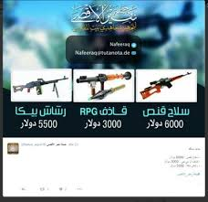
Scenario 3: Terrorism Funding 3 (LPV)
Scenario description:
Returning terrorist fighter displays terrorist behavior or radicalisation
They are very isolated and refuse to engage
The narration of the scenario should be extended
The title of the scenario is missing

Slide 106
Scenario 3: Terrorism Funding 3 (LPV)
Current practices :
Interview neighbors:
Monitor movements
Speak to target
Interrogate target, perform a house search, confiscate material for evidence

Slide 107
Scenario 3: Terrorism Funding 3 (LPV)
Data to be used:
Only fake/pubic data is available
Type of data :
specifiy the type of data
keywords not provided

Slide 108
Scenario 3: Terrorism Funding 3 (LPV)
Objectives :
“He lives a very isolated lifestyle and does not wish to engage in conversation”
A dataset that should contain videos of terrorism content can be used in order to detect persons or vehicles that probably matched with the suspects. Additionally items such as flags or clothes can be detected. Clothes possible gives a sign of radicalization.

Slide 109
Scenario 3: Terrorism Funding 3 (LPV)
Pending issues :
The narration of the scenario should be extended
What is the objective? e.g to detect persons that have radicalized ?
The title of the scenario is missing
What are the evidence data and what are the databases to be analysed?
specifiy the type of data
keywords not provided
Can we merge the afoementioned three scenarios ?
Are these snecarios related with the use case 3
how to adress this
Status of action points of the last Telco:
No action points

Slide 110
Scenario 4: Terrorism Funding
NPN - Netherlands

Slide 111
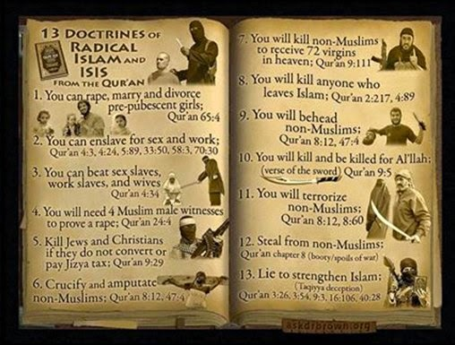
Scenario 4: Terrorism Funding (NPN)
Scenario description:
Financial investigations use third parties to gather / update information
Institutions bound by US Office of Foreign Assets Control (OFAC) list and Combined Targeted Financial Sanctions List of the EU
Officers prefer not to give details because of ongoing investigations
A general picture of terrorism financing including:
Questions about MO (how)
Types of people / organisation involved
General indication of size
Relation to other criminal acts
Trends in these observations
The title of the scenario is missing

Slide 112
Scenario 4: Terrorism Funding (NPN)
Current practices :
Practices difficult to describe – they are conducted in cooperation with other agencies and their own data.
Information generally obtained via Office automation or generally supported formats
Proprietary formats used when organistions use common tools
i.e. Analyst, Notebook, Ibase etc.)

Slide 113
Scenario 4: Terrorism Funding (NPN)
Current practices :
Detection
Banks and financial institutions identify and report suspect transactions.
The Finance Intelligence Unit determine if they are possibly terrorism related
Subjects might be known as terrorism related or facilitating
An investigation can be started
Detection can be from actual investigations or accidental discoveries
No current systematic broad scanning of internet / social media

Slide 114
Scenario 4: Terrorism Funding (NPN)
Current practices :
Selection
Light touch police investigation to enhance the case
Full enquiry of police information,
including Open Source to supplement it.
Related persons included
NO information from taxes / other government institutions at this point
Case bought to committee to determine further action
Official investigation (by police and or other government units) or No further action

Slide 115
Scenario 4: Terrorism Funding (NPN)
Current practices :
Selection
Light touch police investigation to enhance the case
Full enquiry of police information,
including Open Source to supplement it.
Related persons included
NO information from taxes / other government institutions at this point
Case bought to committee to determine further action
Official investigation (by police and or other government units) or No further action

Slide 116
Scenario 4: Terrorism Funding (NPN)
Data to be used:
OSINT data are provided, especially keywords in order to generate a public dataset
Text data:
names and surnames
ip adresses
emails (text)
queries (text)
Visual and text data:
online web sites (sites of drugs)
social media accounts

Slide 117
Scenario 5: Counterfeit/falsified medicine, drugs and NPS (NPN)
Objectives :

Slide 118
Scenario 4: Terrorism Funding (NPN)
Pending issues :
Titlte is missing. Does the parther agree with the selected tittle?
The scenario Narrative is missing
Additional feedback is necessary
The objectives of this scenario should be defined
Available forensic data for investigation
What are the evidence data and what the databases to be analysed?
Status of action points of the last Telco:
AP8: To update the descriptions

Slide 119
Scenario 5: Terrorism Funding
CAST - United kingdom

Slide 120
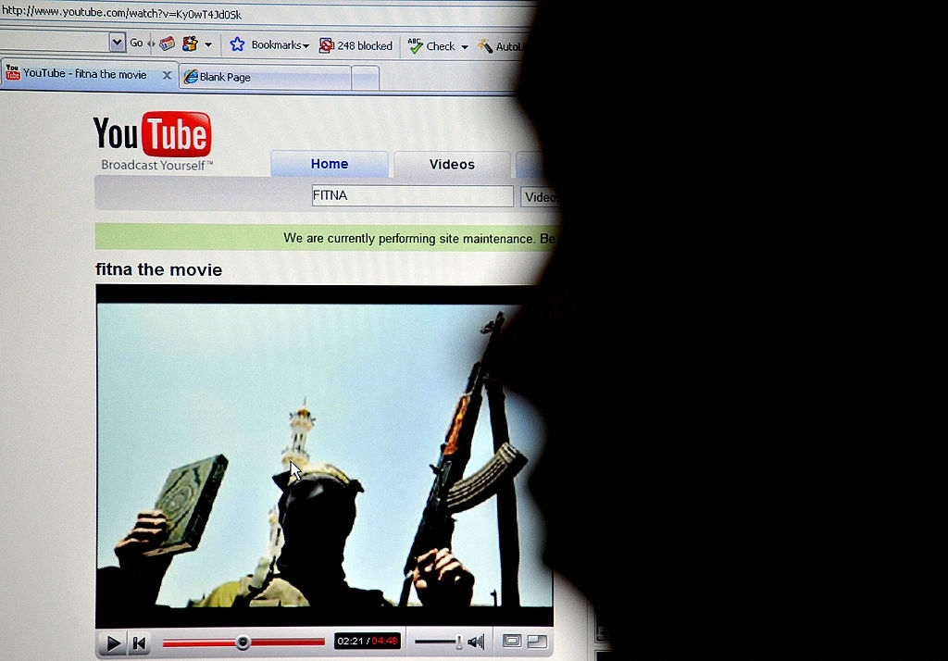
Scenario 5: Terrorism Funding (CAST)
Current practices :
These procedures enable the sharing of ‘suspicious’ transactions which are subsequently investigated
In addition UK LEAs have web searching tools for identifying ‘key word’ searching to identify terrorist activity

Slide 121
Scenario 5: Terrorism Funding (CAST)
Data to be used:
Only fake/pubic data is available
Type of data :
specifiy the type of data
keywords not provided

Slide 122
Scenario 5: Terrorism Funding (CAST)
Objectives :
objectives need to be defined

Slide 123
Scenario 5: Terrorism Funding (CAST)
Pending issues :
The title of the scenario is missing
specifiy the type of data
keywords not provided
What is the objective to investigate in ANITA?
Available forensic data for investigation:
What are the evidence data and what databases are to be analysed?
Status of action points of the last Telco:
AP11: Detailed information about datasets and how we can process them in ANITA (objectives to be defined)

Slide 124
Functional Requirements in Use Cases
Participants : CAST, CERTH, KWPG, AoC, NPN, GDCOC, LPV

Slide 125
Functional requirements per Use Case and Scenario
 | UC-1 (Pharmaceuticals) |  |  |  |  |  |  | UC-2 (Firearms) |  |  |  |  | UC-3 (Funding)
Service | 1 | 2 | 3 | 4 | 5 | 6 | 7 | 1 | 2 | 3 | 4 | 5 | 1 | 2 | 3 | 4 | 5
Data sources and stream analysis
Data source risk assessment in the Surface Web, Deep Web and Dark Nets | Y | Y | Y | Y | Y | ? | ? | Y | Y | Y | N | Y | Y | Y | Y | Y | Y
Black markets discovery and monitoring | Y | Y | Y | Y | Y | ? | ? | Y | Y | Y | N | Y | Y | Y | Y | Y | Y
Content acquisition from Surface Web and pre-processing | Y | Y | Y | Y | Y | ? | ? | Y | Y | Y | N | Y | Y | Y | Y | Y | Y
Block chain analysis for illicit activity discovering | Y | Y | Y | ? | Y | ? | ? | Y | N | N | N |  | Y | Y | Y | Y | Y
Construction of source network and filtering | Y | Y | Y | Y | Y | ? | ? | Y | Y | Y | N | Y | Y | Y | Y | Y | Y
Big Data analysis and analytics
Multilingual Text analysis | Y | Y | Y | N | N | ? | ? | Y | Y | Y | N | N | Y | Y | Y | Y | Y
Image and Video analysis | Y | Y | Y | N | N | ? | ? | Y | Y | Y | Y | N | Y | Y | Y | N | Y
Multilingual automated translation | Y | Y | Y | N | Y | ? | ? | Y | Y | Y | N | N | Y | Y | Y | Y | Y
Multilingual speech to text | ? | ? | ? | N | N | ? | ? | Y | Y | Y | N | N | Y | Y | Y | Y | Y
Illegal trafficking trend analysis | Y | Y | Y | N | N | ? | ? | Y | Y | Y | N | N | Y | N | N | Y | N
Visual Indexing | Y | Y | Y | N | N | ? | ? | Y | Y | Y | Y | N | Y | ? | ? | N | Y

Slide 126
Functional requirements per Use Case and Scenario
 | UC-1 (Pharmaceuticals) |  |  |  |  |  |  | UC-2 (Firearms) |  |  |  |  | UC-3 (Funding)
Service | 1 | 2 | 3 | 4 | 5 | 6 | 7 | 1 | 2 | 3 | 4 | 5 | 1 | 2 | 3 | 4 | 5
Knowledge generation and reasoning
Knowledge modelling for illegal trafficking | Y | Y | Y | N | N | ? | ? | Y | Y | Y | N | N | Y | Y | Y | N | N
Black markets and illegal shops and products tracking | Y | Y | Y | N | N | ? | ? | Y | Y | Y | N | N | N | N | N | N | N
Reasoning mechanisms for criminal network reconstruction | Y | Y | Y | N | N | ? | ? | Y | Y | Y | N | N | Y | Y | Y | N | N
Knowledge based browsing, search and retrieval | Y | Y | Y | N | N | ? | ? | Y | Y | Y | Y | N | Y | Y | Y | N | N
Extraction of evolving knowledge from deep neural network representations | Y | Y | Y | N | N | ? | ? | Y | Y | Y | N | N | ? | ? | ? | N | N
Integration of human factor in the analysis loop
Implicit and explicit user feedback capturing | ? | Y | Y | N | N | ? | ? | Y | Y | Y | Y | N | N | N | N | N | N
Adaptive user modelling for cognitive states estimation | Y | Y | Y | N | N | ? | ? | Y | Y | Y | N | N | N | N | N | N | N
Incorporation of conscious and subconscious user feedback in deep learning representations | ? | Y | Y | N | N | ? | ? | Y | Y | Y | N | N | N | N | N | N | N
Knowledge transfer to new officers | Y | Y | Y | N | N | ? | ? | Y | Y | Y | Y | N | Y | Y | Y | N | N
Novel applications for LEAs and System Integration
Big Data infrastructure | Y | Y | Y | Y | Y | ? | ? | Y | Y | Y | N | Y | N | N | N | Y | Y
Novel applications for illegal trafficking | Y | Y | Y | N | N | ? | ? | Y | Y | Y | N | N | N | N | N | N | N
Advanced Big Data Visual Analytics | Y | Y | Y | Y | ? | ? | ? | Y | Y | Y | N | Y | N | N | N | Y | N
Chain of custody and evidence export | Y | Y | Y | Y | Y | ? | ? | Y | Y | Y | N | Y | N | N | N | Y | Y

Slide 127
Thank you!!!
The end...

